Slide 1

FINANCIAL PRODUCTS & SERVICES ECOSYSTEM
Effective Investment Solutions - Accompanying Prosperity
Bao Viet Securities Joint Stock Company (BVSC)

Slide 2



WHY CHOOSE BVSC?
Bao Viet Group Member: A leading financial institution in Vietnam.
20+ Years Experience: Extensive history and deep market insights.
Multi-channel Support: In-person, Hotline 19001018, and Online.

Slide 3



SPECIAL PROMOTIONS 2026
Welcome Gift
Low Fees
Ecosystem Voucher
100,000 VND
0.15%
Up to 2M VND
For new eKYC accounts on first successful login.
Applied to Web and App trading platforms.
Bao Viet Insurance vouchers based on monthly fees.

Slide 4
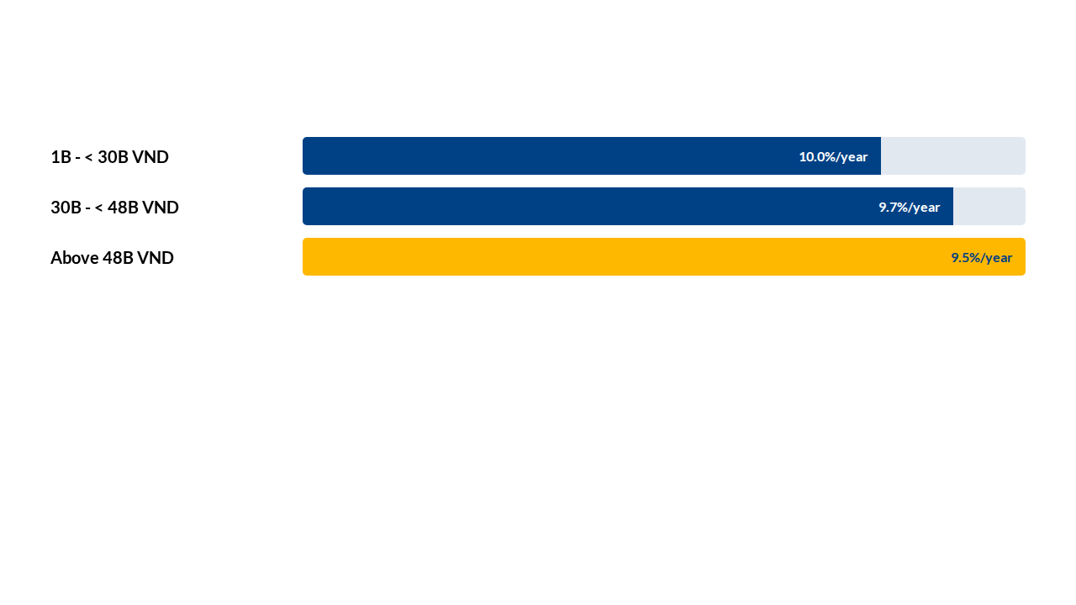

WHALE CLIENT MARGIN POLICY
"5 Golden Days" Privilege
0% Interest for the first 5 days of disbursement. Effective until June 25, 2026.

Slide 5
BROKERAGE & CAPITAL SUPPORT
Securities Brokerage
Capital Support
1:1 Advisory Team: Personalized strategies tailored to your financial goals.
Margin Trading: Competitive rates and a flexible list of top-tier stocks.
In-depth Analysis: Daily macro, corporate, and bond-themed reports.
Cash Advance: Receive funds instantly after order matching to capture new opportunities.

Slide 6






CORE VALUES & COMMITMENTS
Safety
Security
Convenience
Independent management of client and company assets, ensuring absolute transparency.
Modern technology systems meeting the highest security standards in the market.
Trade and manage assets anytime, anywhere through a comprehensive digital ecosystem.
"Prestige and professionalism are the prerequisites."

Slide 7



OPEN-ENDED FUND SERVICES
Internal Fund
Partner Funds
BVFED Fund: Focuses on potential stock portfolios, managed by BVSC's experts to provide superior long-term returns.
Collaborating with leading fund management units:
Dragon Capital: VFMVF1, VFMVF4, VFMVFA
Dai-ichi Life: DFVN CAF, DFVN FIX
Suitable for clients who seek methodical investment but have limited time to track the market.

Slide 8


DIGITAL ECOSYSTEM
BVSC Invest (Mobile App)
Quick eKYC
Intuitive interface, fast execution, and 24/7 portfolio management.
Open an account online and start trading immediately on the same day.
BWise (Web Trading)
BVS@LiveBoard
Advanced platform with professional technical analysis tools.
High-speed, real-time market data updates.

Slide 9




INSTITUTIONAL SERVICES
Brokerage & Execution
Investment Networking
Fast processing of block trades, effectively minimizing price impact.
Organizing site visits and meetings with senior management for funds.
Deep Analysis
NPF Services
Macro and corporate reports focused on ESG and long-term growth.
Professional capital management for non-profit organizations.

Slide 10



INVESTMENT BANKING (IB)
ECM / Capital Markets
DCM / Debt Markets
M&A
IPO Advisory, Private Placements, and Share Auctions.
Corporate Bond Issuance and Loan Structuring.
Strategic Partner Search and Due Diligence.
Strength: Inheriting the prestige of Bao Viet Group - A guarantee for deal success.

Slide 11




TRACK RECORD
Top M&A Advisory: Recognized for excellence in 2024-2025.
Top 10 HNX Governance: Leading enterprise in Corporate Governance.
Sustainable Enterprise:
8 consecutive years in CSI Top 100.
Major Clients: SABECO, GELEX, HDBank, and more.

Slide 12

Partner With Us
Experience a professional financial environment with expert guidance across all channels.
1900 1018
Direct Network
Hotline Support
Nationwide Presence
© 2026 Bao Viet Securities Joint Stock Company (BVSC)

